Slide 1
React Hooks
in practice
Nguyen Viet Hung, KMS Technology Oct. 2019

Slide 2
React Hooks
Overview
Introduce Hooks API
Custom hooks
Hooks vs Higher-order component
Unit tests for React Hooks

Slide 3
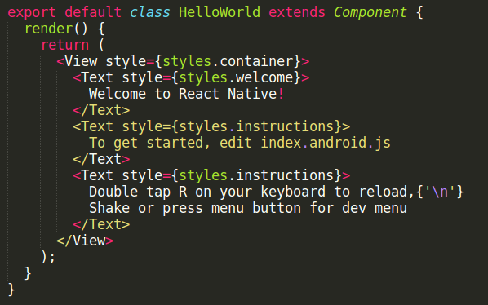
Overview - React Component

Slide 4
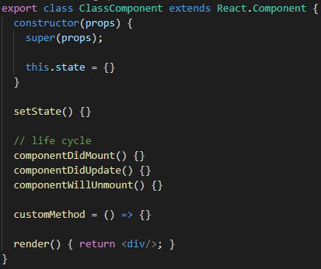
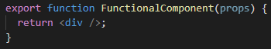
Overview - Class component vs Fn component

Slide 5

Overview - Hooks
React 16.8
Support Functional Components
Why?
JavaScript is functional programming
Hooks are simple
Reduce line of codes
Powerful

Slide 6
Overview
The Pokédex Demo

Slide 7
Introduce Hooks API
01
const [state, setState] = useState(initialState);
setState(newState);
02
useEffect(() => {
const subscription = source.subscribe();
return () => {
subscription.unsubscribe(); // Clean up the subscription
};
}, [source]);
03
const memoizedCallback = useCallback(() => {
doSomething(a, b);
}, [a, b]);

Slide 8
Custom hooks
What is custom hooks?
Hook is just a JavaScript function, to support React Component.
Custom hook can be:
A normal function with a purpose
A mixed of other hooks

Slide 9
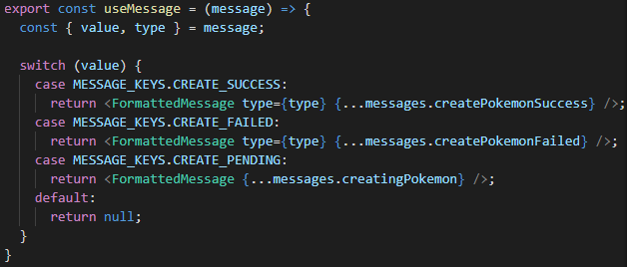
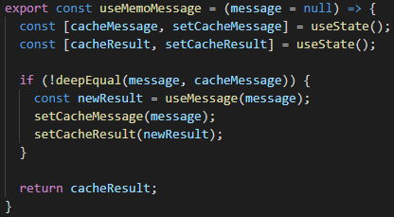
Custom hooks
example

Slide 10
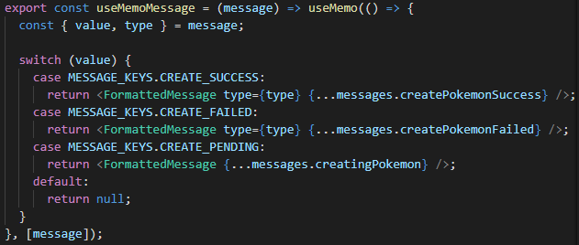
Custom hooks
example

Slide 11
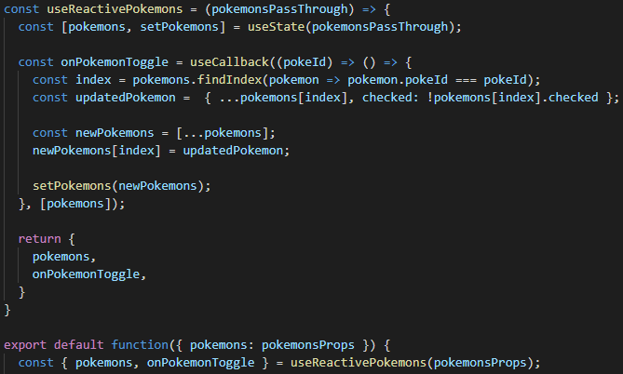
Custom hooks
example

Slide 12
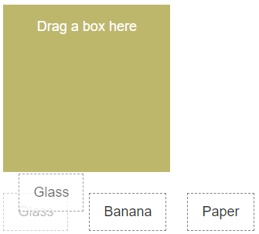
Custom hooks
example
import {
useDrag,
useDrop,
} from 'react-dnd'

Slide 13
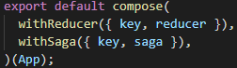
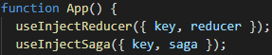
Custom hooks
example
const useInjectSaga = ({ key, saga, mode }) => {
const context = React.useContext(ReactReduxContext);
React.useEffect(() => {
const injectors = getInjectors(context.store);
injectors.injectSaga(key, { saga, mode });
return () => {
injectors.ejectSaga(key);
};
}, []);
};
const useInjectReducer = ({ key, reducer }) => {
const context = React.useContext(ReactReduxContext);
React.useEffect(() => {
getInjectors(context.store).injectReducer(key, reducer);
}, []);
};

Slide 14
Hooks vs Higher-order component
Hooks
Higher-order component
JavaScript function to support React Component
Used for functional component only
Used inside component
Highly reusable
Have to design hooks carefully
Component wrapper to provide additional data and features
Used for any React component
Used by wrapping component
Highly reusable
Have to structure using component well

Slide 15
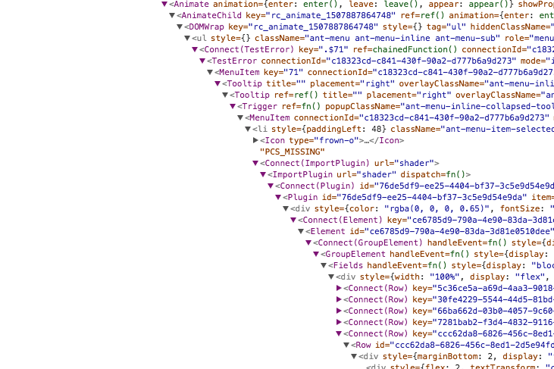
Hooks vs Higher-order component
Higher-order
Component
Wrapper Hell

Slide 16
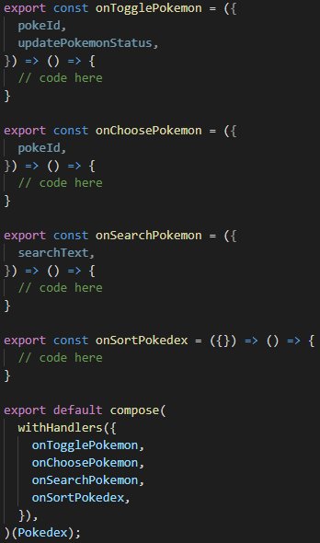
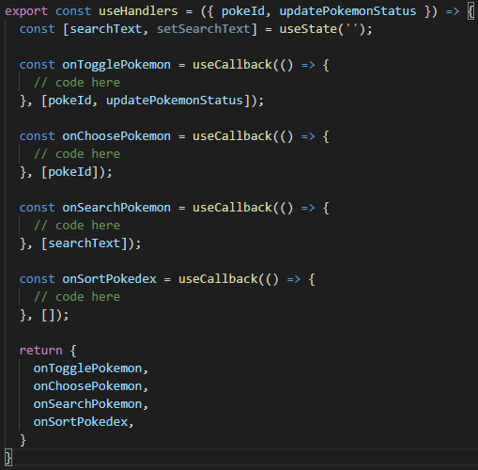
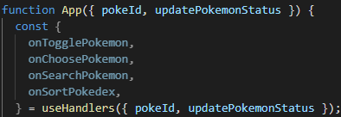
Hooks vs Higher-order component

Slide 17
Hooks vs Higher-order component
connect(
mapStateToProps,
mapDispatchToProps,
)(Component);
import {
useSelector,
useDispatch,
useStore,
} from 'react-redux';
https://react-redux.js.org/next/api/hooks

Slide 18
Hooks vs Higher-order component
withRouter(Component);
import {
useHistory,
useLocation,
useParams,
useRouteMatch,
} from 'react-router';
function Component() {
const history = useHistory();
.
.
history.push('/hook');
https://reacttraining.com/react-router/web/api/Hooks

Slide 19
Unit tests for React Hooks - Setup
Mock Component
npm install --save-dev @testing-library/react-hooks
Implement Callback function
Mock state
Perform life cycle
(update, unmount)
https://github.com/testing-library/react-hooks-testing-library

Slide 20
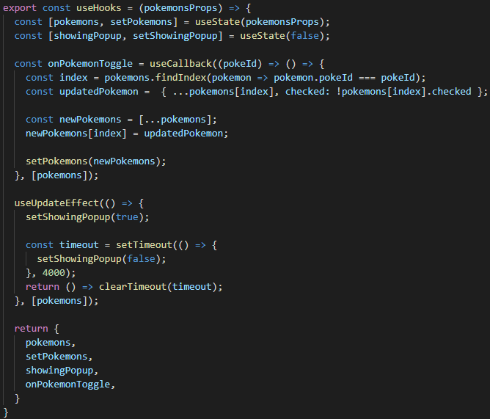
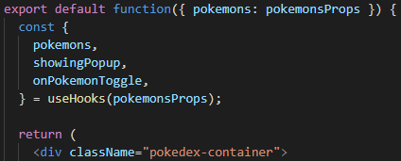
Unit tests for React Hooks - Code splitting
Separate hooks logic to a independent function

Slide 21
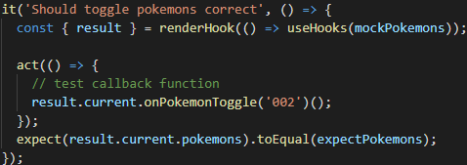
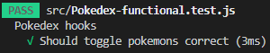
Unit tests for React Hooks - Render hook

Slide 22
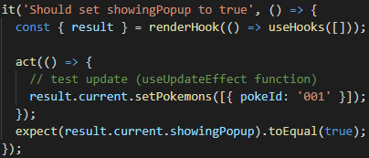
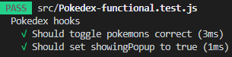
Unit tests for React Hooks - Render hook

Slide 23
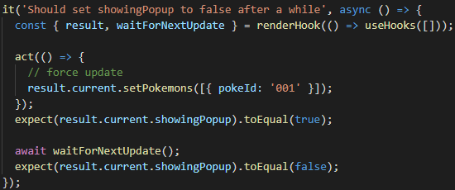
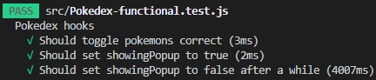
Unit tests for React Hooks - Render hook

Slide 24
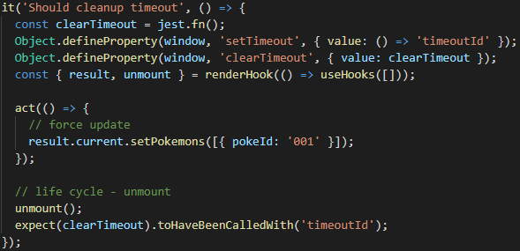
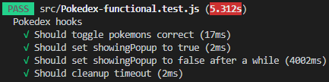
Unit tests for React Hooks - Render hook

Slide 25
Thank you!

